Slide 1

Geometry
Unit 3, Lesson 9 Angle Relationship Proofs – Part 2 Volume 1, pg. 169

Slide 2


Benchmarks
MA.912.GR.1.1
Prove relationships and theorems about lines and angles. Solve mathematical and real-world problems involving postulates, relationships, and theorems of lines and angles.
MA.912.LT.4.10
Judge the validity of arguments and give counterexamples to disprove statements.
volume 1, pg. 169

Slide 3
Integrated Mathematical Thinking and Reasoning Standards
MA.K12.MTR.1.1 Actively participate in effortful learning both individually and collectively.
MA.K12.MTR.4.1 Engage in discussions that reflect on the mathematical thinking of self and others.
MA.K12.MTR.5.1 Use patterns and structure to help understand and connect mathematical concepts.
volume 1, pg. 169

Slide 4

Learning Target
I can prove relationships using parallel lines and their transversals.
volume 1, pg. 169

Slide 5

Warm-Up
volume 1, pg. 170

Slide 6
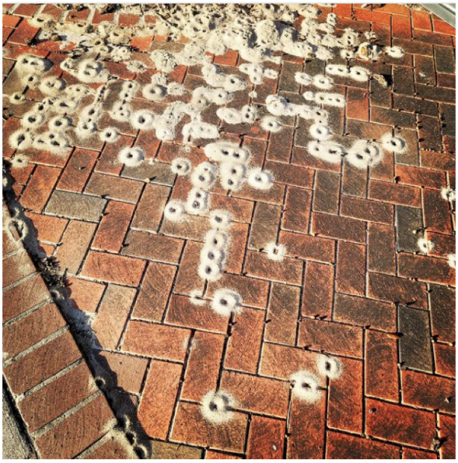
3.9.1 Warm-Up: Notice and Wonder
A photo of ant hills taken in Gainesville, Florida is shown.
What do you notice?
What do you wonder?
Write a caption for the photo.
volume 1, pg. 170

Slide 7

Activity
volume 1, pg. 170

Slide 8

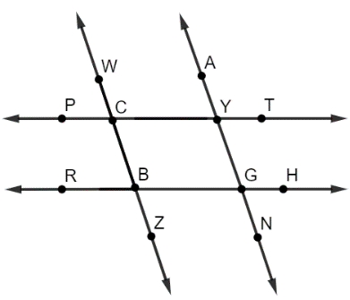
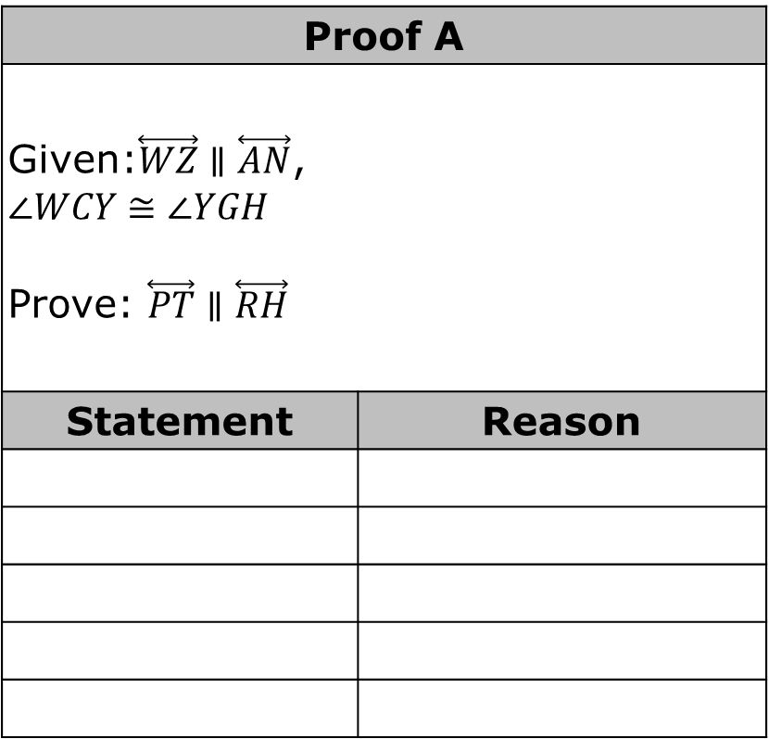
3.9.2 Activity: Card Sort
With your group, sort through the statements and reasons for each proof. Then, write each proof in the tables provided.
Proof A
Given:$\overset{⃡}{WZ}∥\overset{⃡}{AN}$, $$∠WCY≅∠YGH$$ Prove: $\overset{⃡}{PT}∥\overset{⃡}{RH}$
Statement | Reason
volume 1, pg. 170

Slide 9
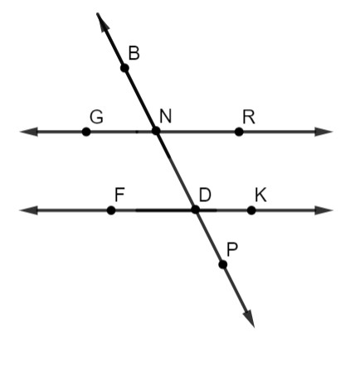
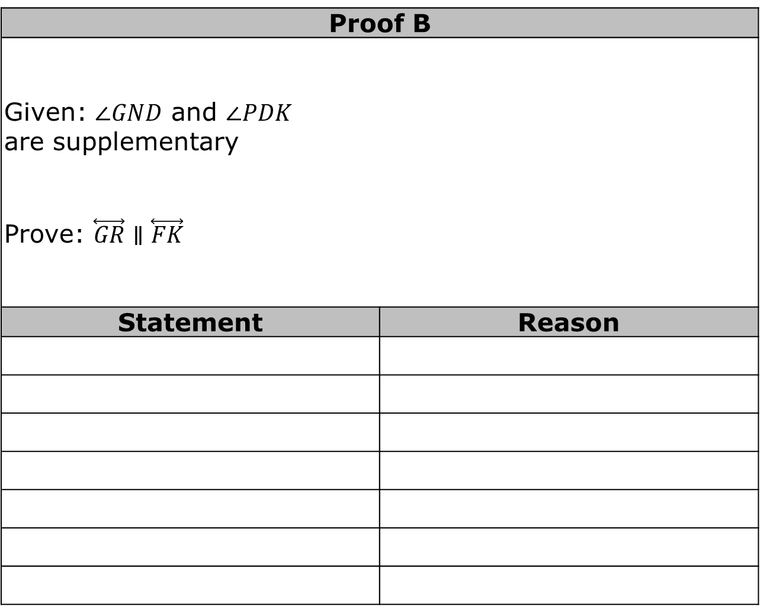
Proof B
Given: $∠GND$ and $∠PDK$ are supplementary Prove: $\overset{⃡}{GR}∥\overset{⃡}{FK}$
Statement | Reason
volume 1, pg. 171

Slide 10
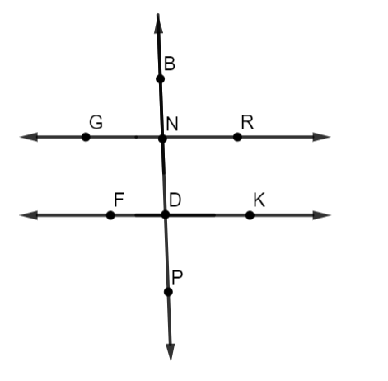
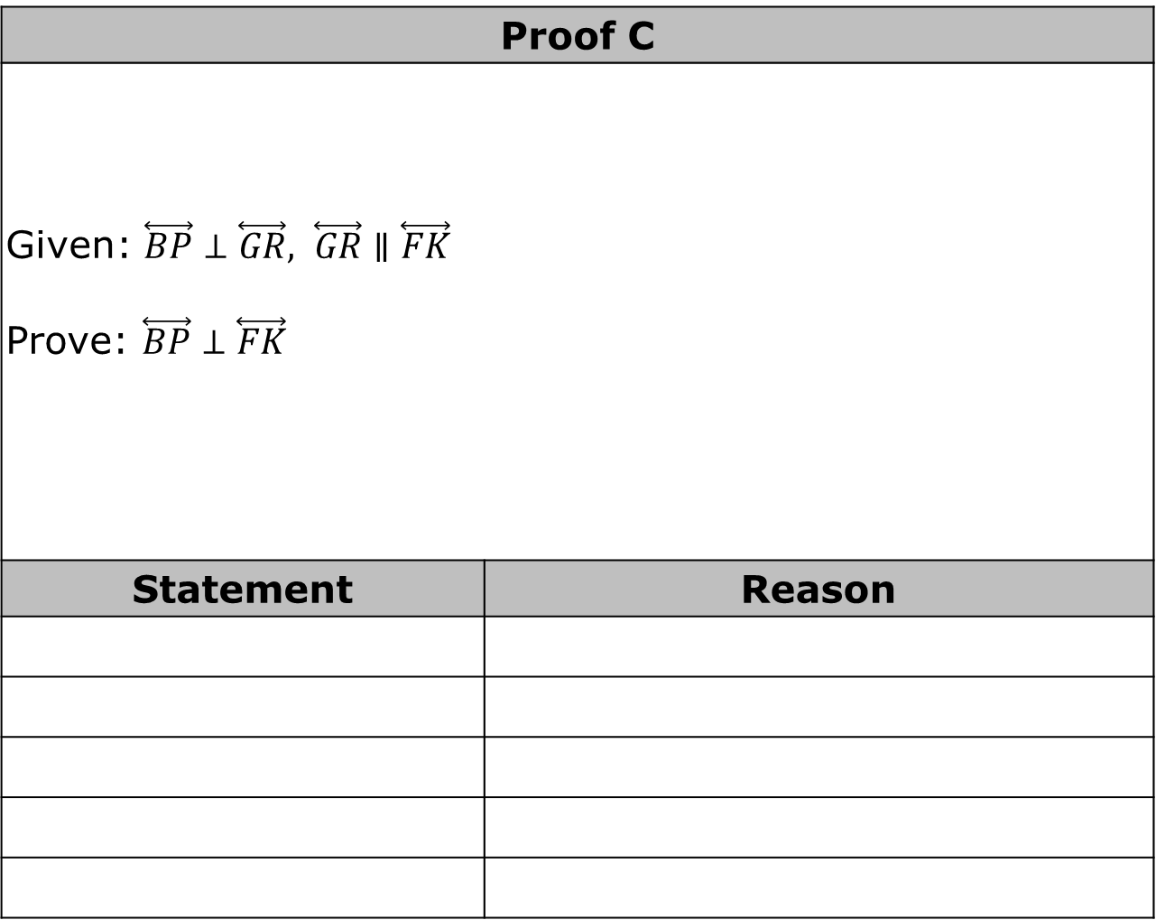
Proof C
Given: $\overset{⃡}{BP}⊥\overset{⃡}{GR}, \overset{⃡}{GR}∥\overset{⃡}{FK}$ Prove: $\overset{⃡}{BP}⊥\overset{⃡}{FK}$
Statement | Reason
volume 1, pg. 171

Slide 11
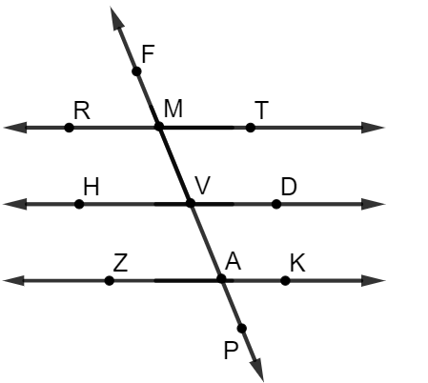
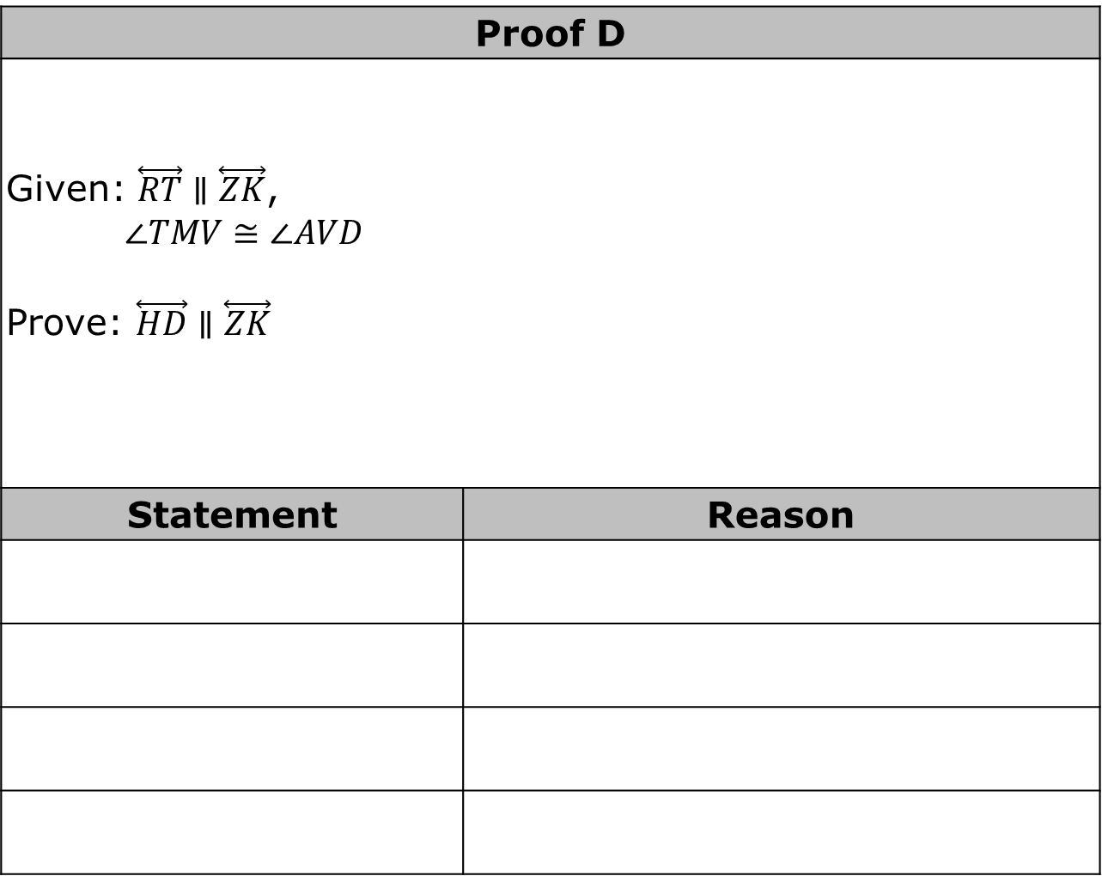
Proof D
Given: $\overset{⃡}{RT}∥\overset{⃡}{ZK}$, $$∠TMV≅∠AVD$$ Prove: $\overset{⃡}{HD}∥\overset{⃡}{ZK}$
Statement | Reason
volume 1, pg. 172

Slide 12
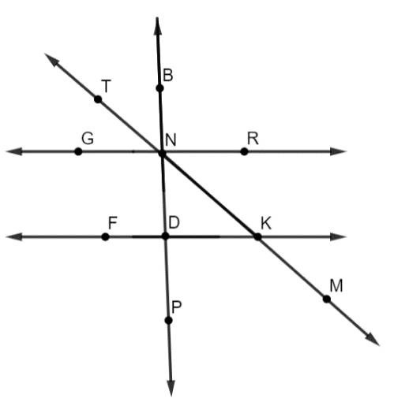

Proof E
Given: $\overset{⃡}{BP}⊥\overset{⃡}{GR}$and $$\overset{⃡}{BP}⊥\overset{⃡}{FK}$$ Prove: $∠DKM$ and $∠GNT$ are supplementary
Statement | Reason
volume 1, pg. 172

Slide 13
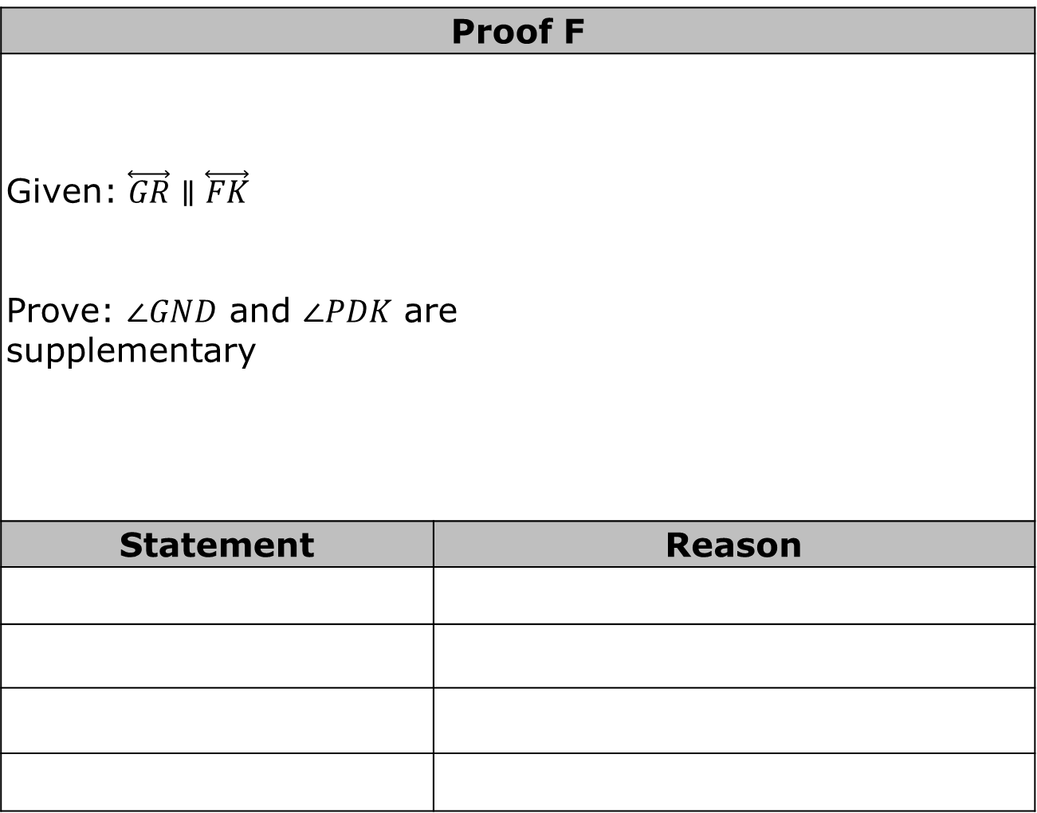
Proof F
Given: $\overset{⃡}{GR}∥\overset{⃡}{FK}$ Prove: $∠GND$ and $∠PDK$ are supplementary
Statement | Reason
volume 1, pg. 173

Slide 14
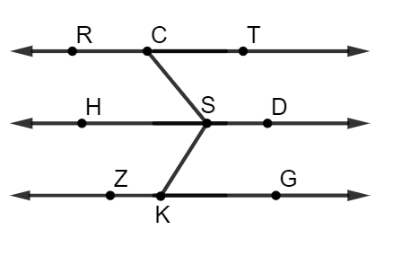
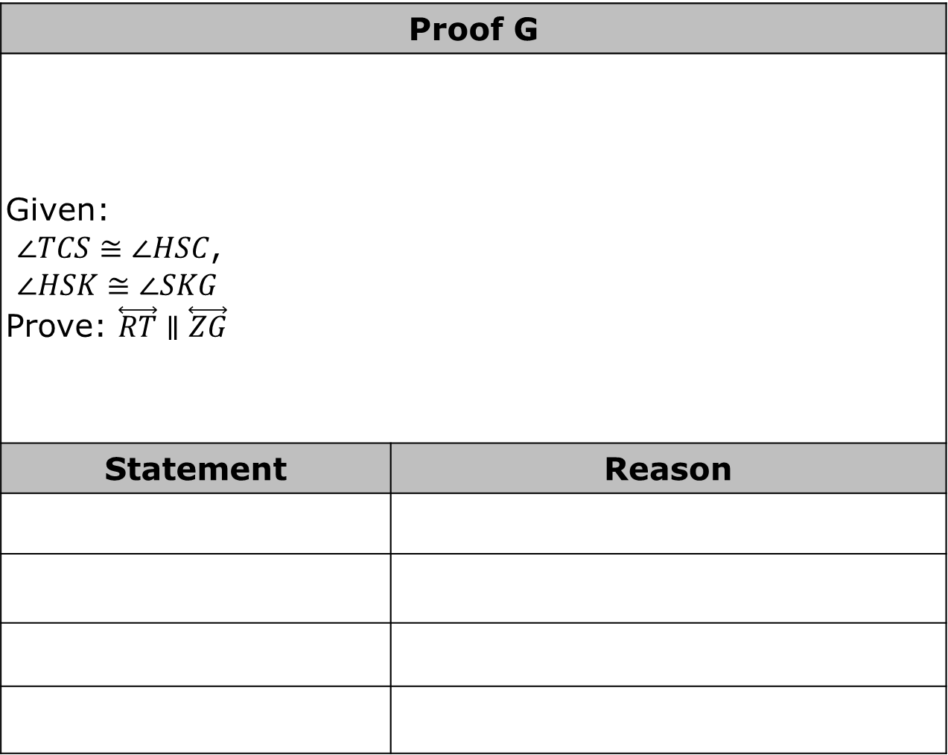
Proof G
Given: $∠TCS≅∠HSC$, $∠HSK≅∠SKG$ Prove: $\overset{⃡}{RT}∥\overset{⃡}{ZG}$
Statement | Reason
volume 1, pg. 173

Slide 15
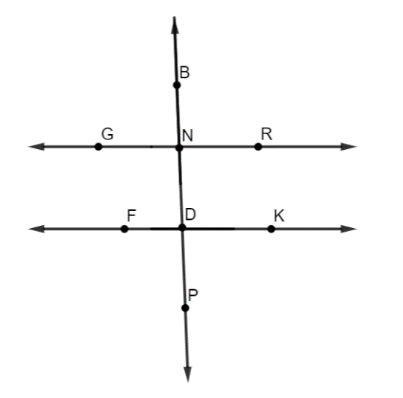

Proof H
Given: $\overset{⃡}{GR}⊥\overset{⃡}{BP}$ and $\overset{⃡}{FK}⊥\overset{⃡}{BP}$ Prove: $\overset{⃡}{GR}∥\overset{⃡}{FK}$
Statement | Reason
volume 1, pg. 174

Slide 16

Wrap-Up
volume 1, pg. 174

Slide 17
3.9.3 Wrap-Up: Cool Down
Write an explanation to a classmate who might have missed today’s lesson, in your own words, about what you’ve learned about angle relationship proofs. Include things that are easy to remember and common errors to watch out for.
volume 1, pg. 174

